Slide 1
Blacktivists In The Archive
Presented By: Matthew Stevenson
Original Author: Ed Summers
Course: CS895
2019-03-06
Source: https://news.docnow.io/blacktivists-in-the-archive-71c807aa247e

Slide 2
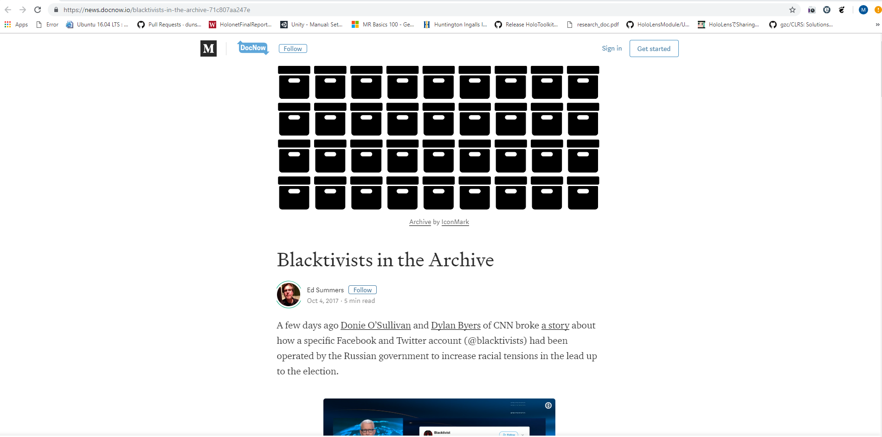
Source: https://news.docnow.io/blacktivists-in-the-archive-71c807aa247e

Slide 3
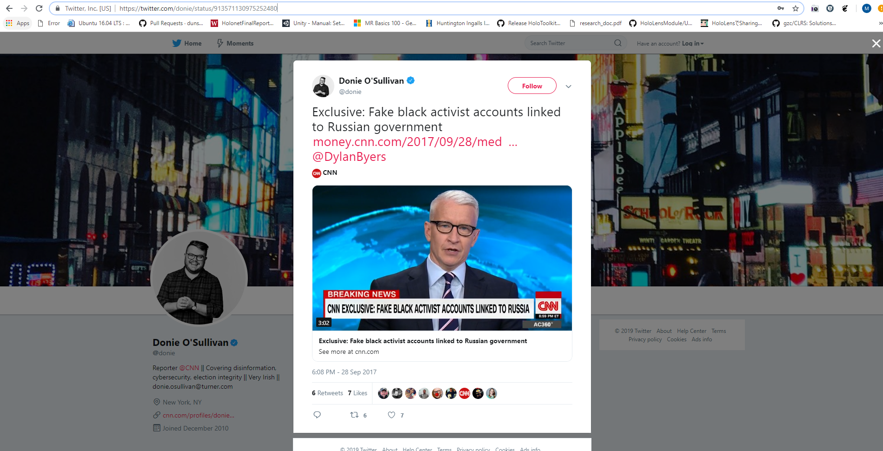
Source: https://twitter.com/donie/status/913571130975252480

Slide 4
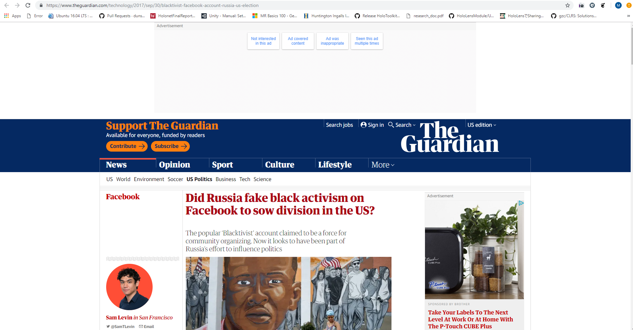
Source: https://www.theguardian.com/technology/2017/sep/30/blacktivist-facebook-account-russia-us-election

Slide 5
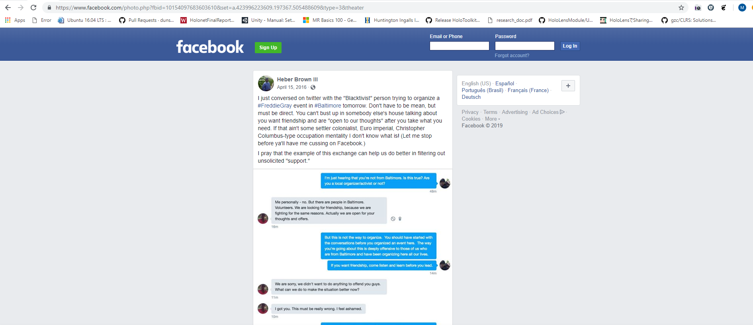
Source: https://www.facebook.com/photo.php?fbid=10154097683603610

Slide 6
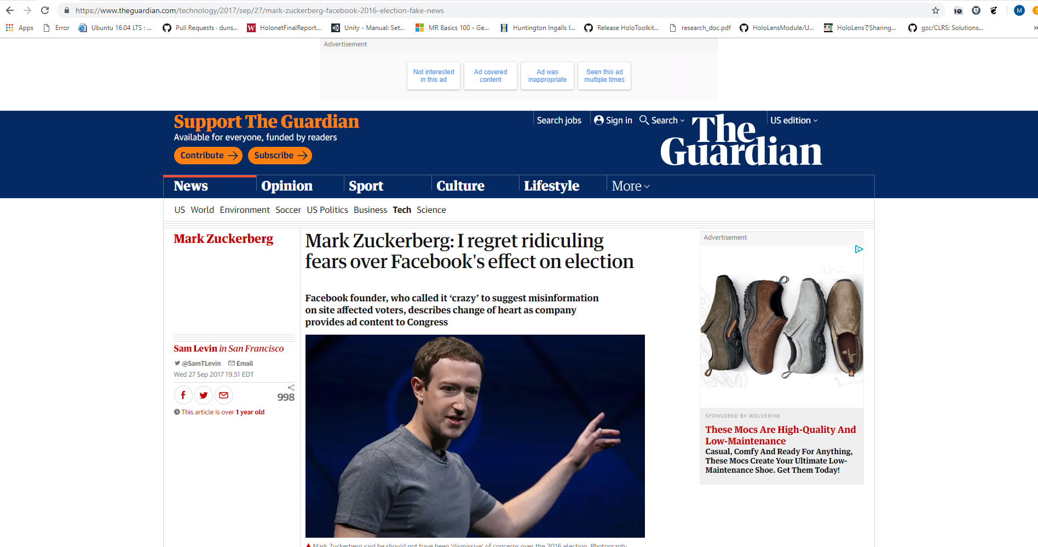
Source: https://www.theguardian.com/technology/2017/sep/27/mark-zuckerberg-facebook-2016-election-fake-news

Slide 7
Russia Influencing American Politics
Blacktivist was a member of 470 linked Russian Facebook accounts and of 200 Twitter accounts
Source: https://news.docnow.io/blacktivists-in-the-archive-71c807aa247e

Slide 8
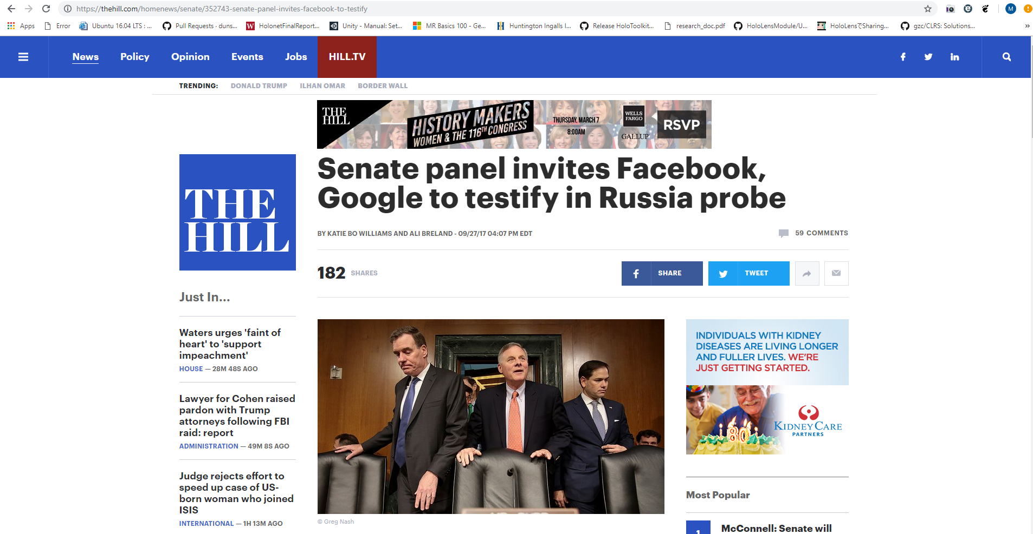
Source: https://thehill.com/homenews/senate/352743-senate-panel-invites-facebook-to-testify

Slide 9
But Why Blacktivist And Do These Accounts Still Exist?
Let’s Take A Look.

Slide 10
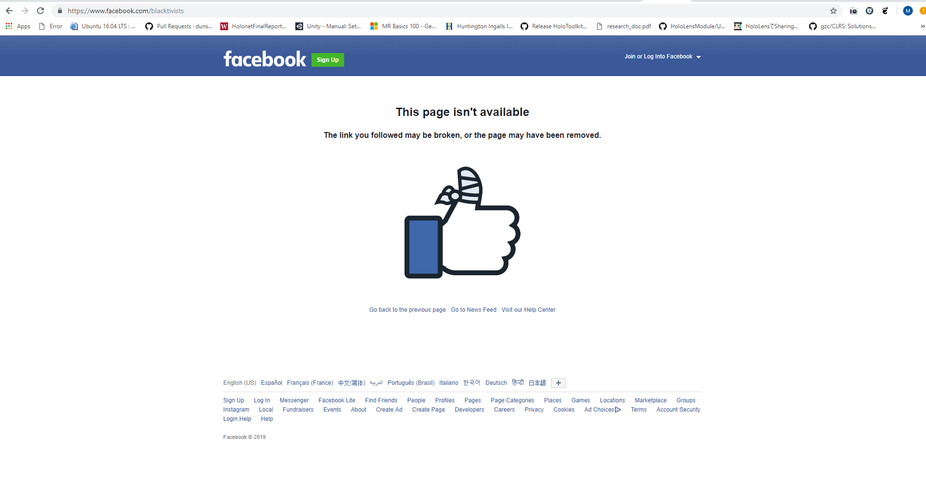
Source: https://www.facebook.com/blacktivists

Slide 11
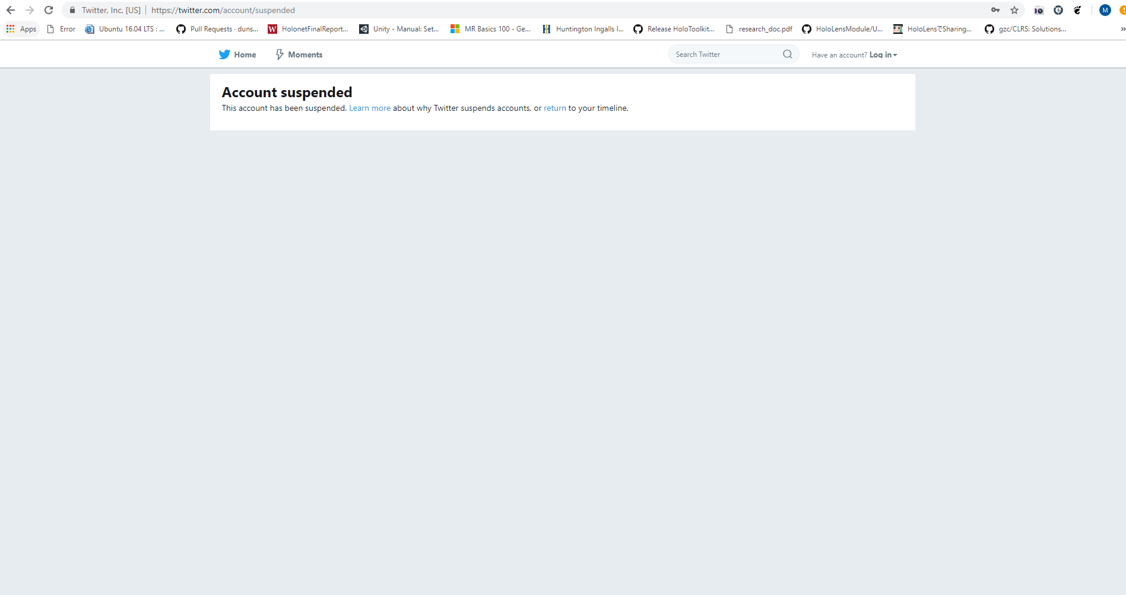
Source: https://twitter.com/account/suspended

Slide 12
Shall We Try Another Method?
Let Us See What Twitter Returns

Slide 13
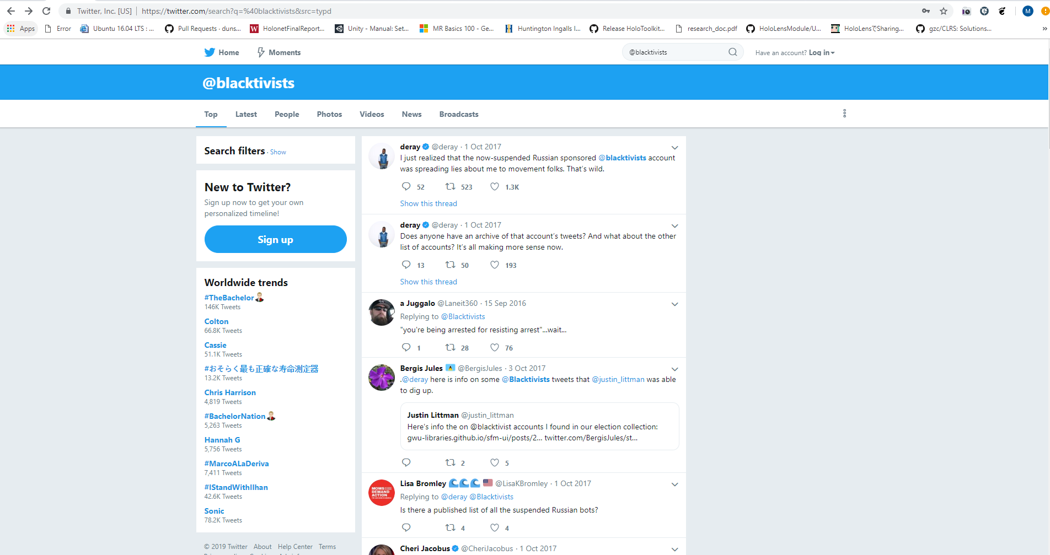
Source: https://twitter.com/search?q=%40blacktivists&src=typd

Slide 14
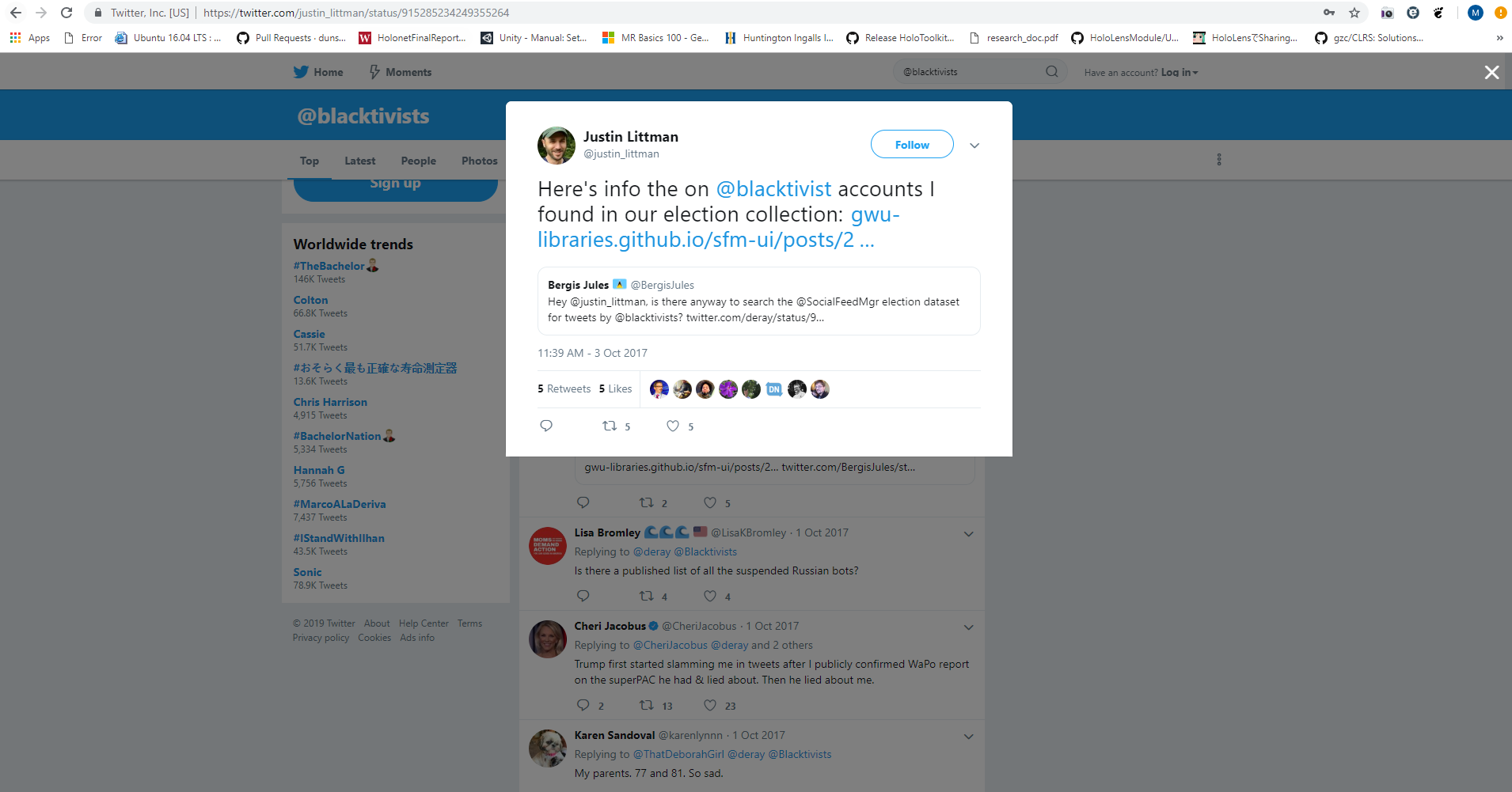
Source: https://twitter.com/justin_littman/status/915285234249355264

Slide 15
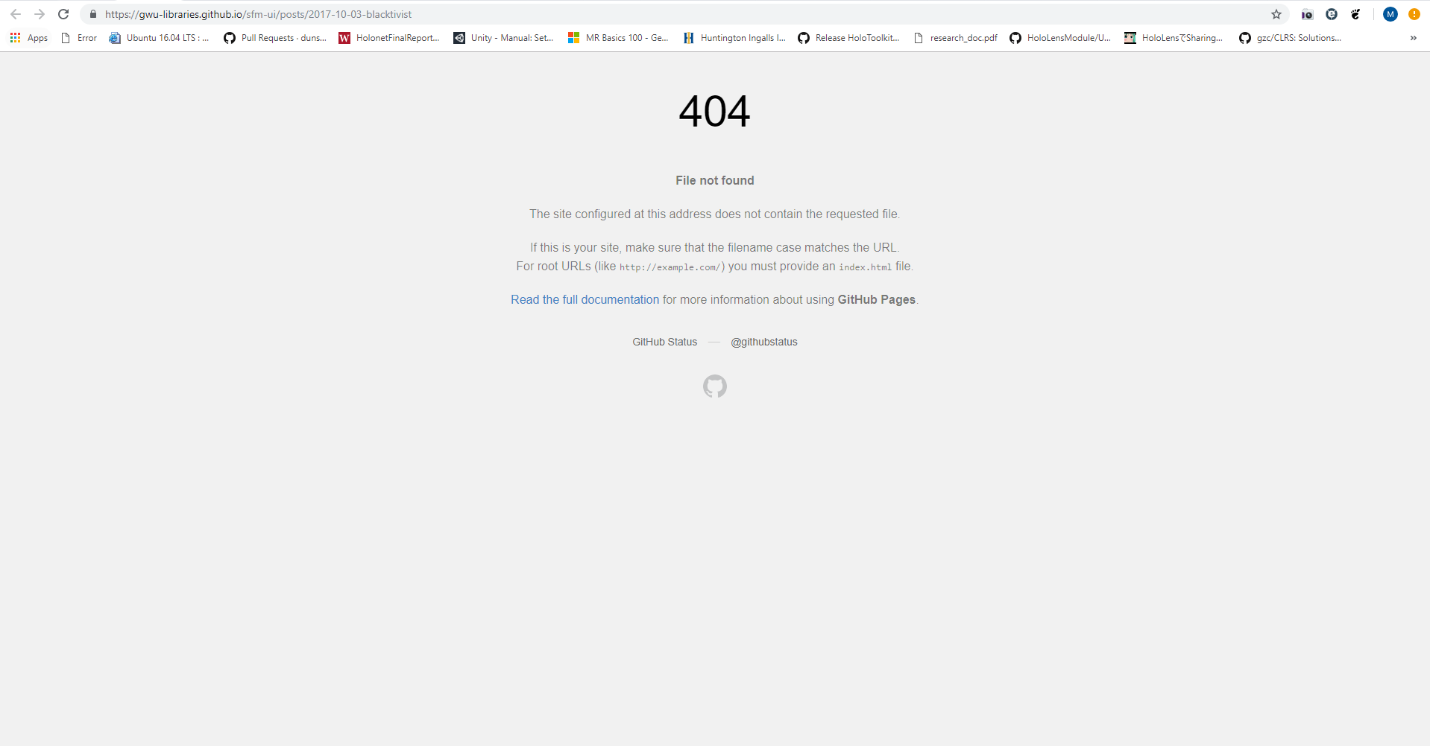
Source: https://gwu-libraries.github.io/sfm-ui/posts/2017-10-03-blacktivist

Slide 16
Is This Another Dead End?
Let Us See What the internet archive can tell us.

Slide 17
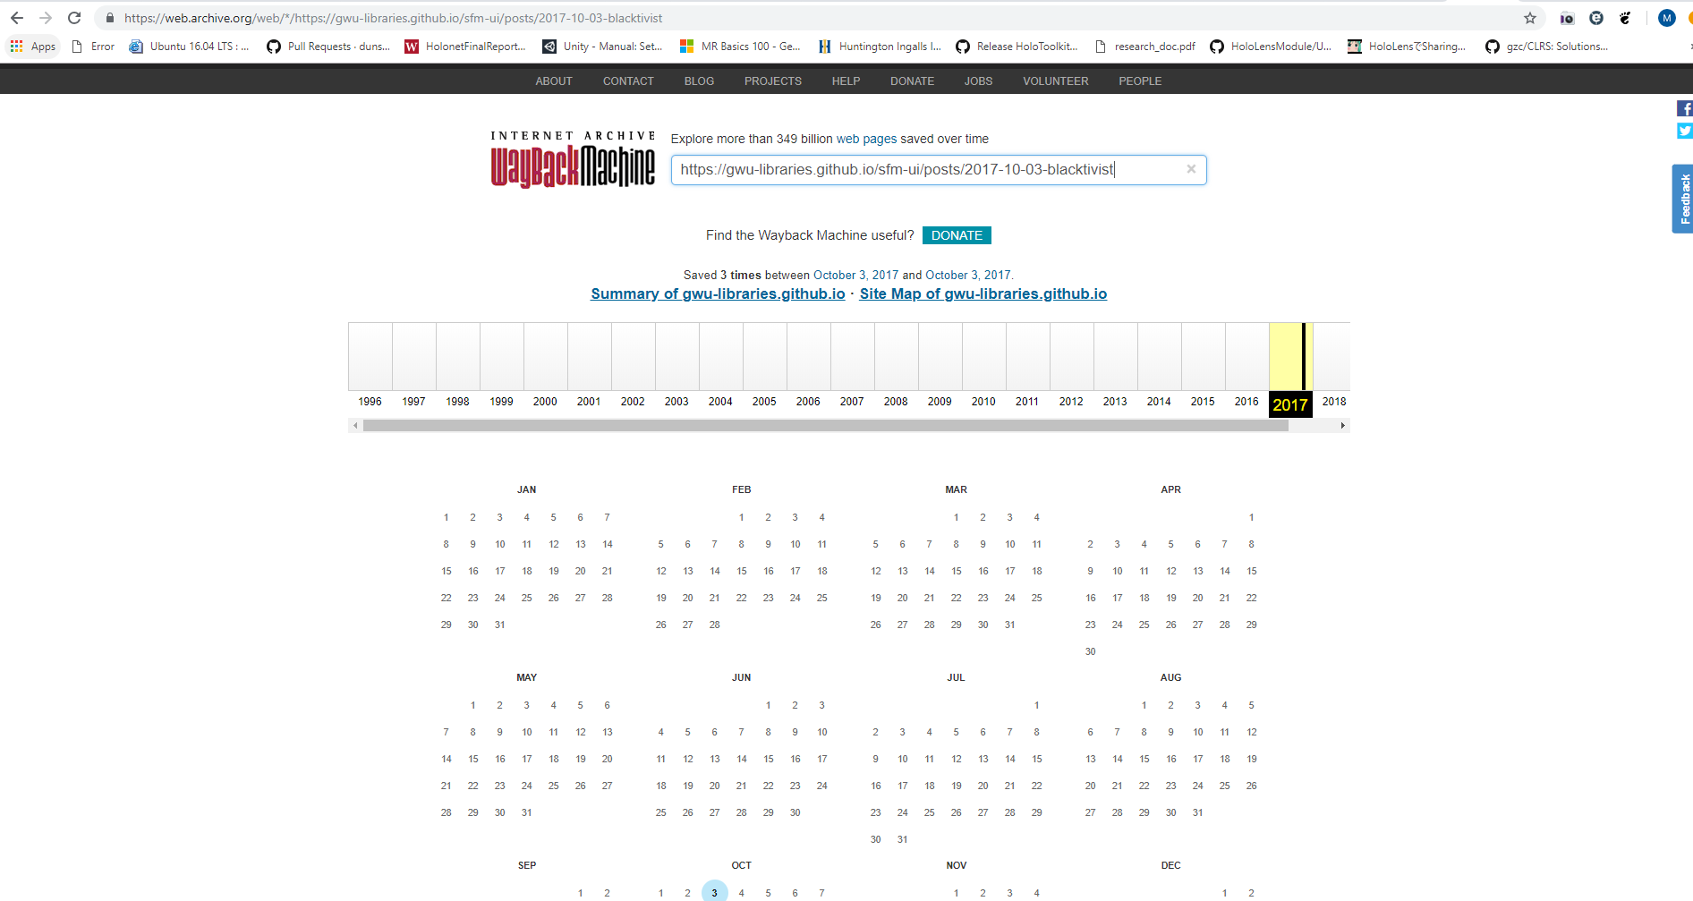
Archive Hit!
Source: https://web.archive.org/web/*/https://gwu-libraries.github.io/sfm-ui/posts/2017-10-03-blacktivist

Slide 18
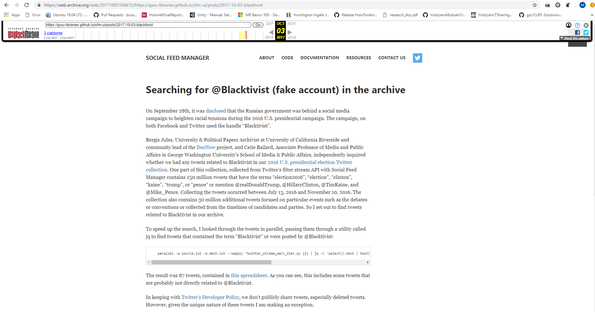
Source: https://web.archive.org/web/20171003184615/https://gwu-libraries.github.io/sfm-ui/posts/2017-10-03-blacktivist

Slide 19
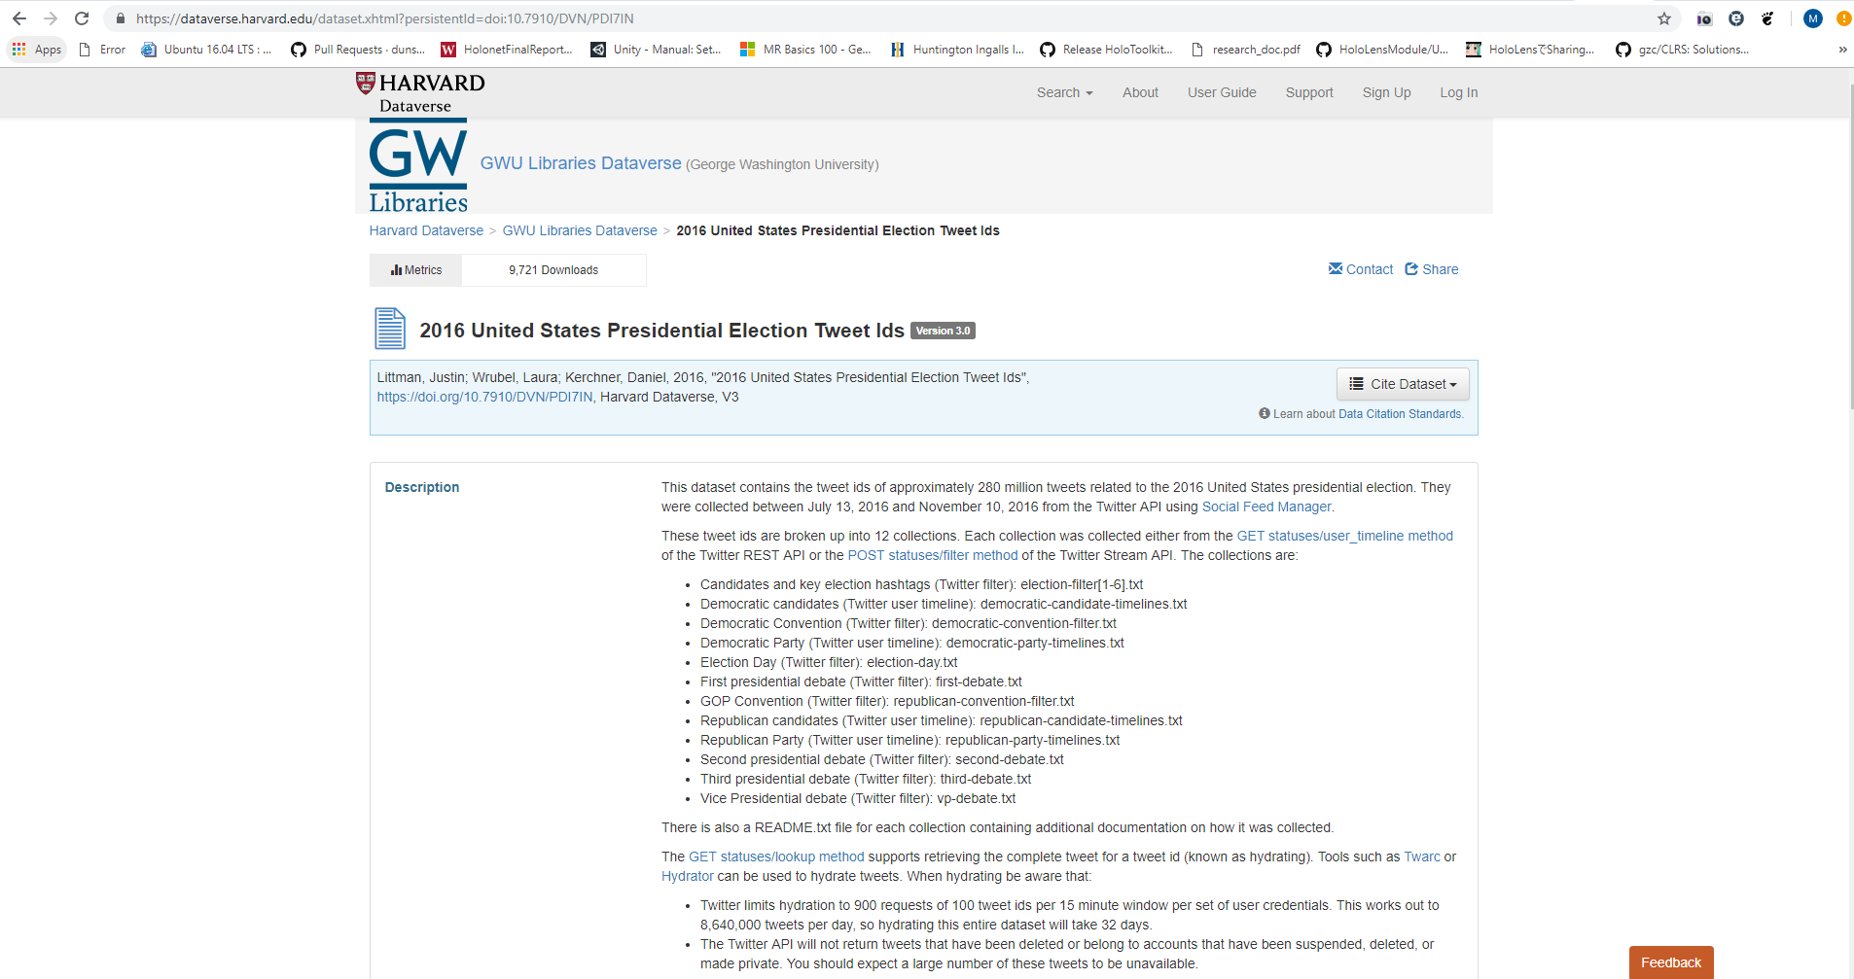
Source: https://dataverse.harvard.edu/dataset.xhtml?persistentId=doi:10.7910/DVN/PDI7IN

Slide 20
Based On The Dataset
For the 2016 US Presidential election Twitter Collection:
Using terms: election2016, election, Clinton, Kaine, Trump, or Pence
Or mentions: @realDonaldTrump, @HillaryClinton, @TimKaine, and @Mike_Pence
@justin_littman concludes with only 87 results, showing little or no association to @Blacktivist

Slide 21
Blacktivist Has Essentially Vanished
But have “they” left any other footprints?

Slide 22
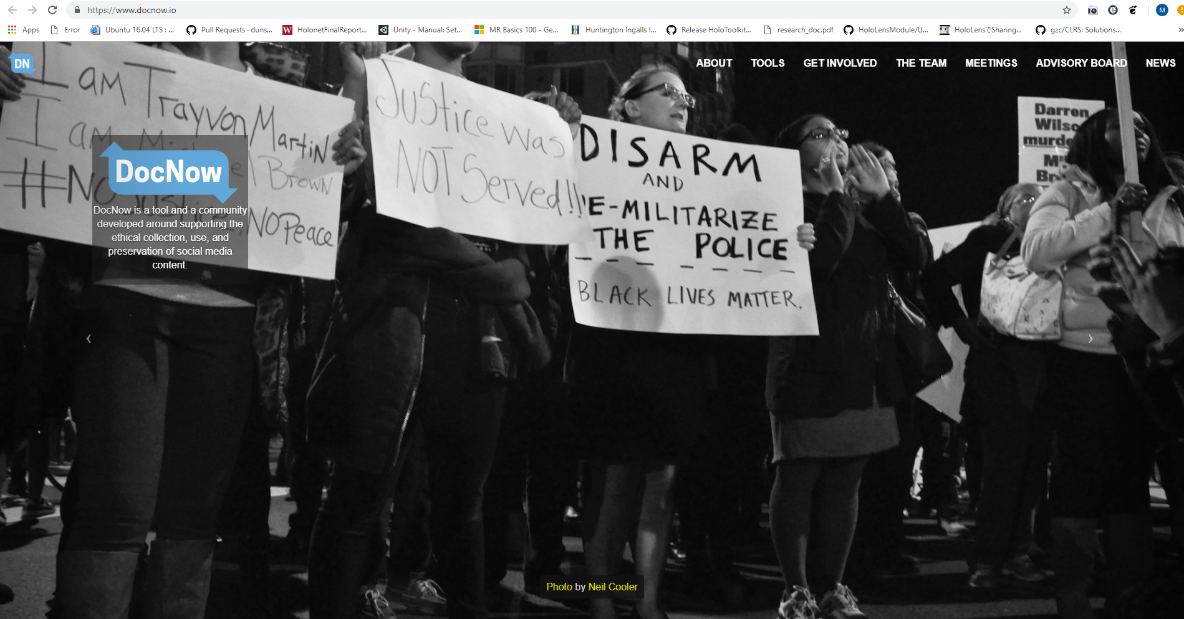
Source: https://www.docnow.io/

Slide 23
Documenting The Now
Let Us See What Was Uncovered

Slide 24
Potentially Valid Conjectures
Based on CNN reports, the use of the apostrophe was inconsistent.
“it`s” instead of “it’s”
14 tweets that used ` and 4 that used ‘
Source: https://news.docnow.io/blacktivists-in-the-archive-71c807aa247e

Slide 25
Can This Mean Multiple Authors?
Let Us Keep Going

Slide 26
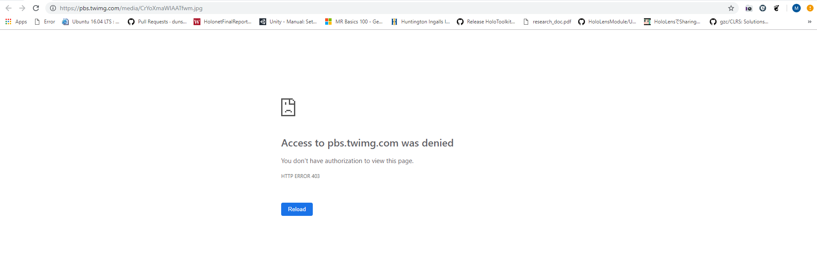
Photo Use Consistency
“98% of the tweets included a photo, all of which have been flagged as unavailable in Twitter’s image cache (HTTP Status 403)” – Ed Summers
Source: https://pbs.twimg.com/media/CrYoXmaWIAATfwm.jpg

Slide 27
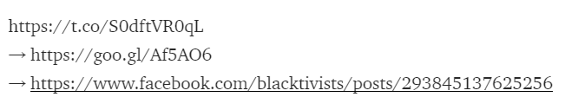
Links To Social Media
18 of the photo tweets linked to Blacktivist Facebook Account
11 used Google URL Shortener
Source: https://news.docnow.io/blacktivists-in-the-archive-71c807aa247e

Slide 28
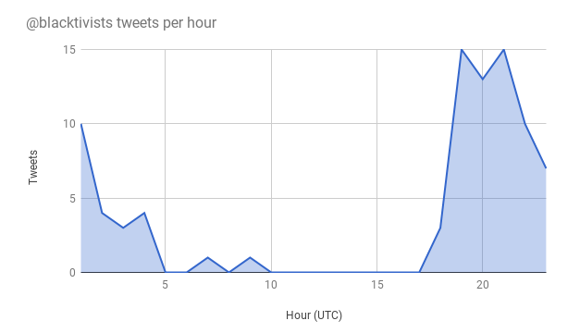
Source: https://news.docnow.io/blacktivists-in-the-archive-71c807aa247e

Slide 29
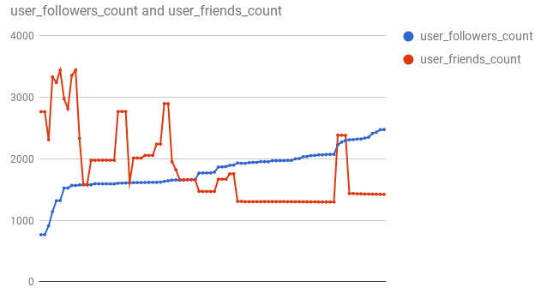
Source: https://news.docnow.io/blacktivists-in-the-archive-71c807aa247e

Slide 30
Based On The Evidence
The Persons Behind the accounts are clearly Human

Slide 31
Should We Not Have Access To This Information?
Let US ReCall…

Slide 32
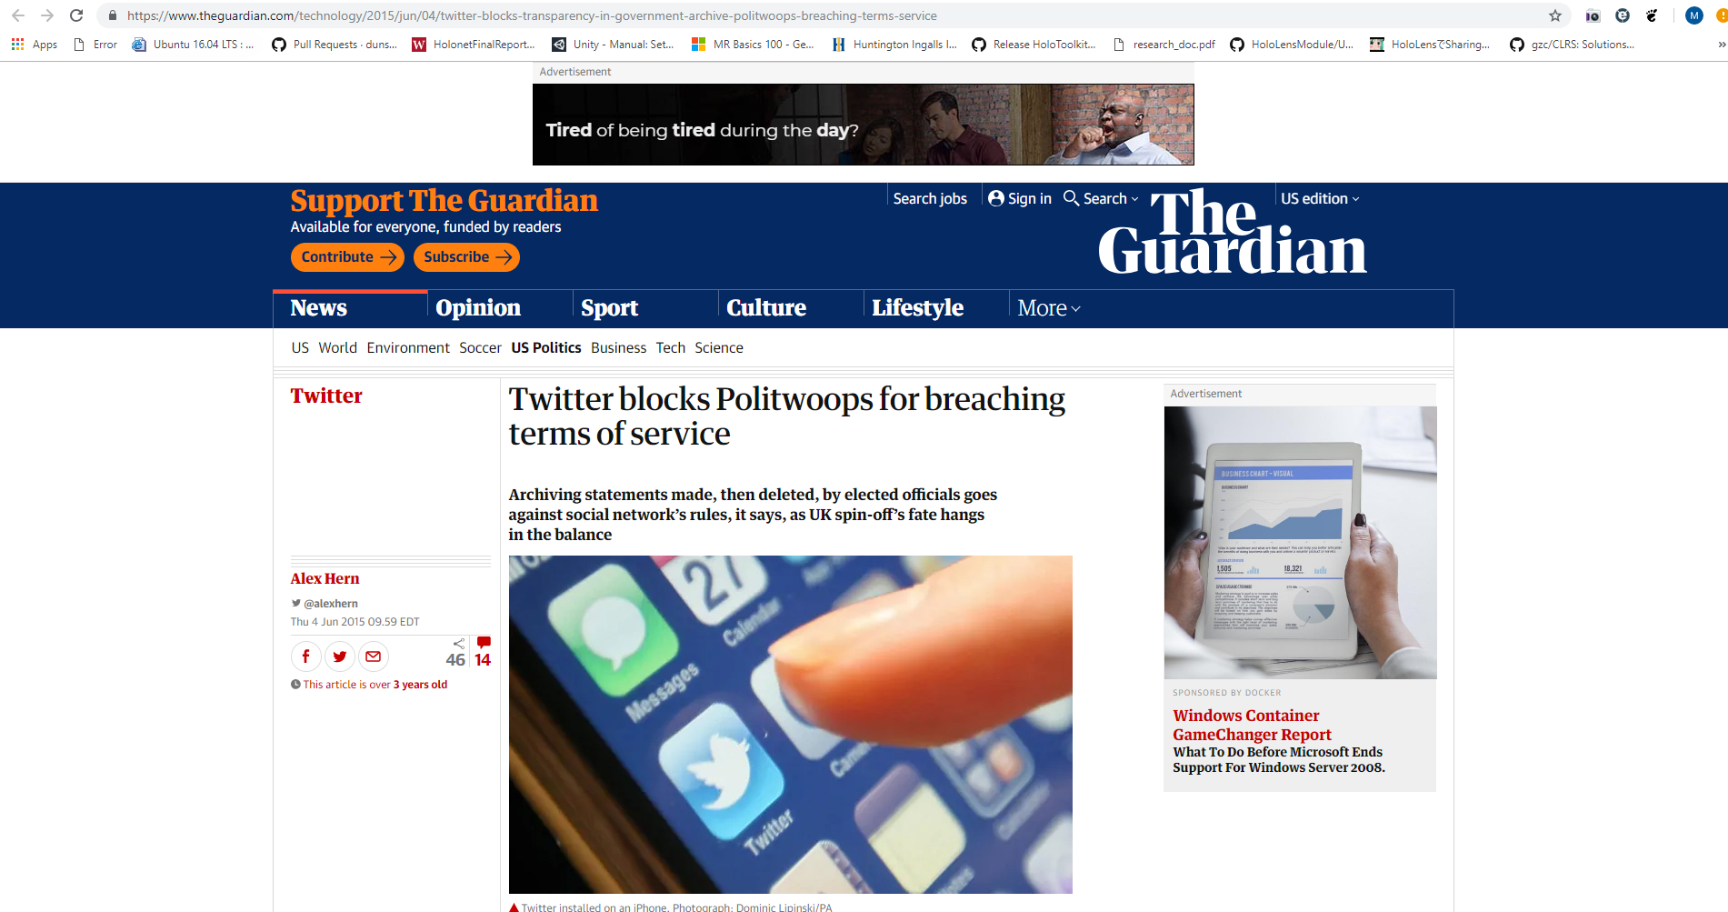
Source: https://www.theguardian.com/technology/2015/jun/04/twitter-blocks-transparency-in-government-archive-politwoops-breaching-terms-service

Slide 33
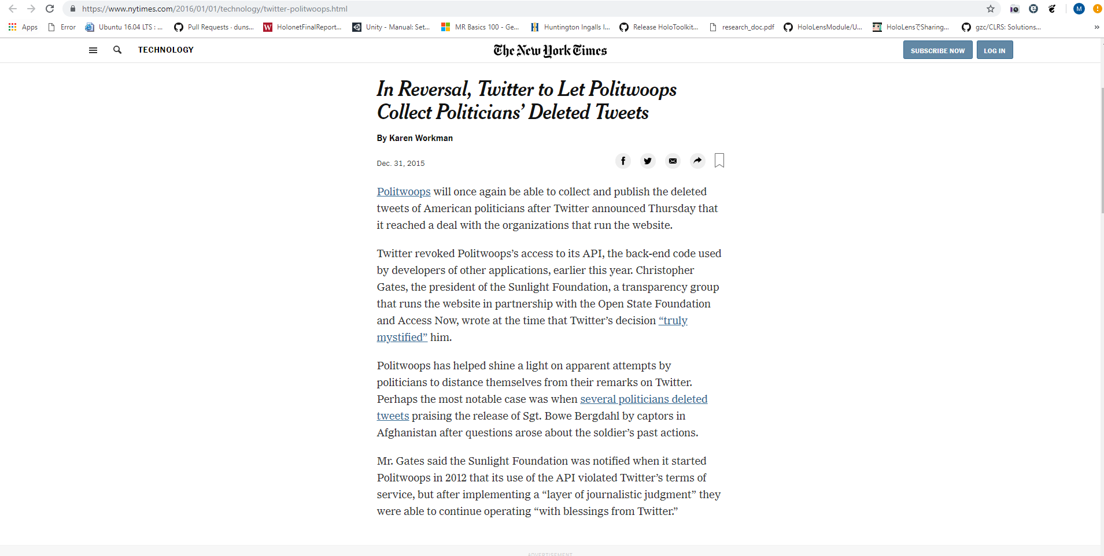
Source: https://www.nytimes.com/2016/01/01/technology/twitter-politwoops.html

Slide 34
Thoughts From The Author
Urges accounts of Blacktivist to become public record
Implies Twitter should follow suit based on Politwhoops decision
Summers presents information through his project, Documenting the Now, to contribute his public service to the community

Slide 35
Concluding Remarks
Social media accounts can appear then disappear quickly leaving a lasting footprint in society
Can potential sway the outcome of a historical event
These types of accounts:
Influence public opinion
Cause public uproar
Spread misinformation
Promote an agenda

Slide 36
Contact Information:
Twitter: @mstev0du
Github: https://github.com/mst3v3nsn
Google Groups: https://groups.google.com/forum/#!forum/cs895-s19

